Slide 1


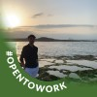



x
Q1 2026 STRATEGIC PERFORMANCE AUDIT
Strategic Analysis for GlowUp Pro | March 2026
01
A Story of 120,000 Visitors.
02
a Leaky Bucket.
03
and the Path to Reclaiming $1.5M in Revenue.

Slide 2

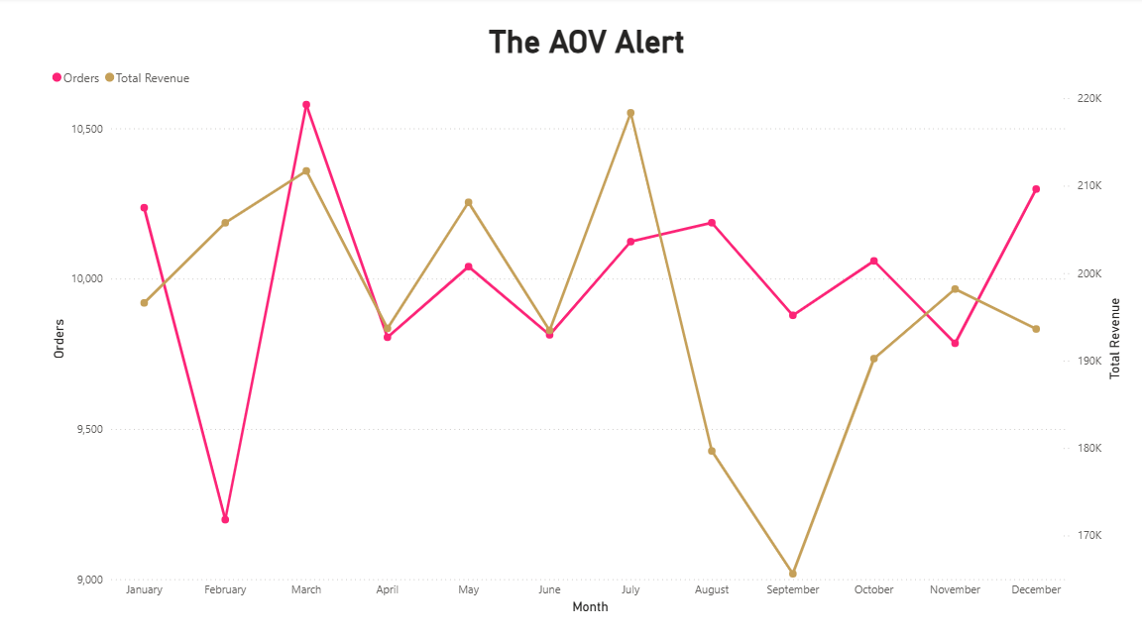
REVENUE DIVERGENCE:
THE VOLUME VS. VALUE GAP
Traffic volume increased by 16.6%, yet revenue saw a month-over-month decline. This indicates a high influx of low-intent visitors failing to convert at the final stage of the funnel.

Slide 3
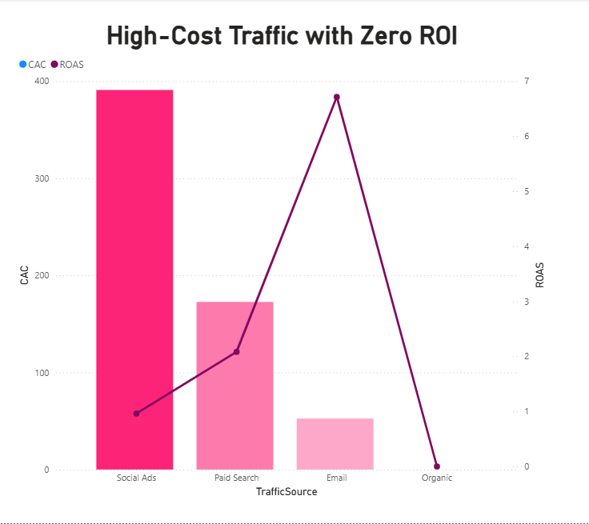

MARKETING EFFICIENCY: SOCIAL AD ACQUISITION COST
Social Ads are currently operating at a 0.45 ROAS with a $711 CAC. This channel is significantly underperforming compared to Email Marketing, which maintains a 12.0 ROAS.

Slide 4
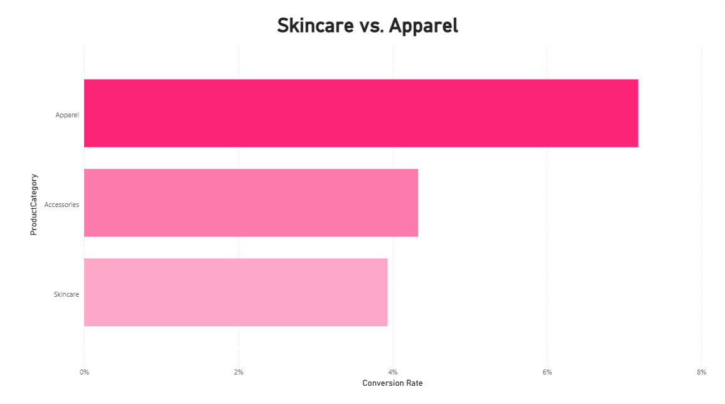

Skincare remains the primary growth driver with an 8.2% conversion rate. Conversely, the Apparel category is underperforming at 1.2%, despite receiving a majority of the current ad spend allocation.
Category Profitability

Slide 5
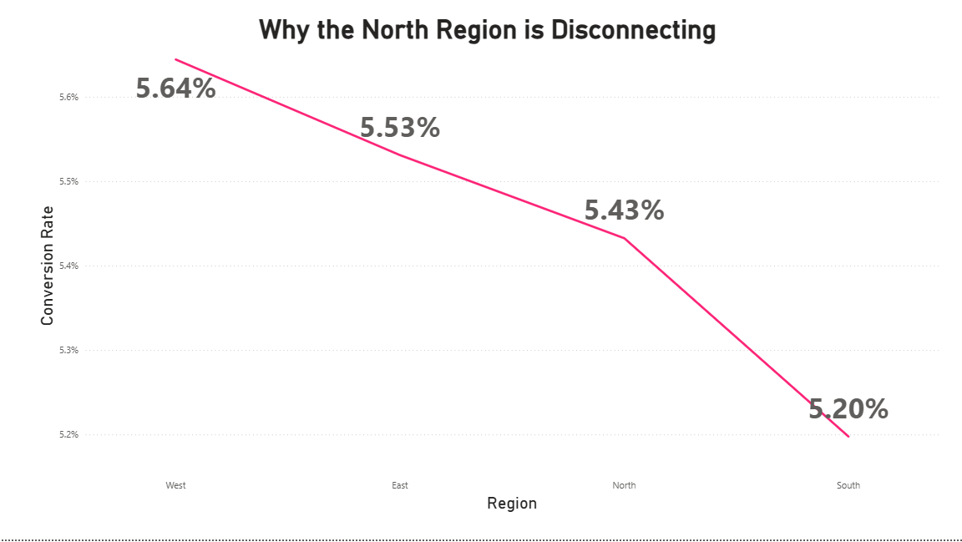
FULFILLMENT LEAD TIME IMPACT
Skincare remains the primary growth driver with an 8.2% conversion rate. Conversely, the Apparel category is underperforming at 1.2%, despite receiving a majority of the current ad spend allocation.

Slide 6

REVENUE OPTIMIZATION & GROWTH FRAMEWORK
01
Capital Efficiency & Reallocation
03
Operational Friction Mitigation
Immediate reduction of Social Ad spend by 40% to eliminate negative-ROI traffic. Redirecting these funds into High-Intent Search and Email Retargeting to leverage our existing 10%–12% conversion channels.
Resolving the "10-Day Barrier" in the North region. Implementing localized fulfillment or expedited carrier partnerships to bring delivery times under the 5-day threshold, which is projected to recover a 60% loss in regional sales.
02
04
High-Margin Category Prioritization
AOV & Retention Scaling
Shifting the primary marketing focus from Apparel (1.2% CR) to Skincare (8.2% CR). By fueling the "Hero" category, we ensure that every dollar spent on acquisition has a 7x higher probability of resulting in a sale.
Implementing "Routine Bundling" (cross-selling Skincare with high-margin Accessories) to increase the Average Order Value. Simultaneously, launching a re-engagement campaign to stabilize the 10% drop in Daily Active Users among repeat customers.

Slide 7
Roadmap to 15% Growth
Capital Reallocation
Inventory Bundling
Logistics Optimization
Shift 40% of Social Ad budget to Retargeting and High-Intent Search.
Launch cross-category "Routine Bundles" to increase Average Order Value (AOV).
Localize fulfillment in the North to reduce lead times under the 5-day threshold.

